Slide 1

PERFUME SELLING WEBSITE
Class: SE1812
Student: Nghiem Thi Hong Ngoc
Lecture: Do Thi Loan
Subject: PRJ301

Slide 2

E-commerce Selling perfume
PerfumePod

Slide 3
Components
Basic: HTML, CSS, Javascript, Java, JSP, Servlet
Addition: Bootstrap, font awesome, Map API, Chart.js

Slide 4
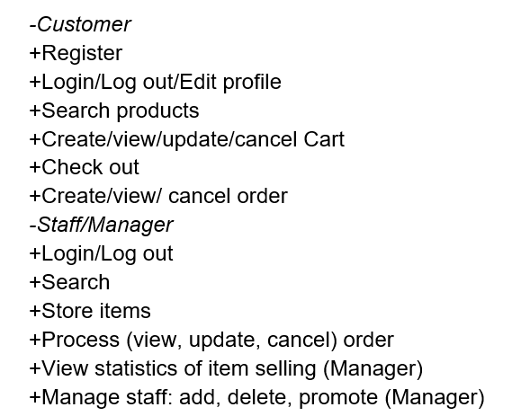
Function

Slide 5
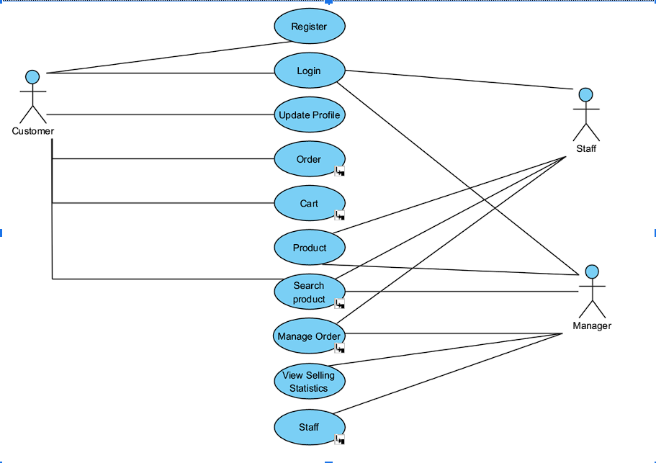
Use case Diagram

Slide 6
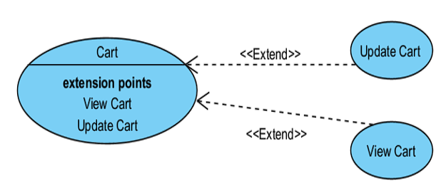
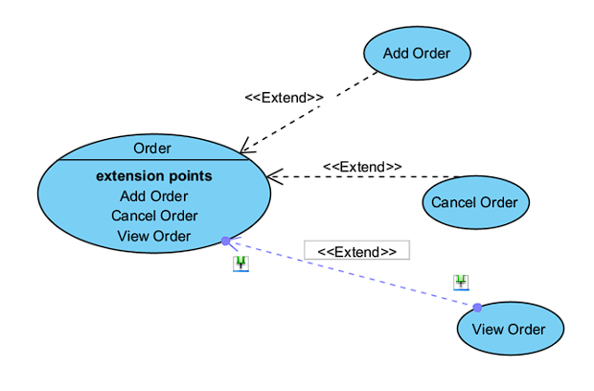
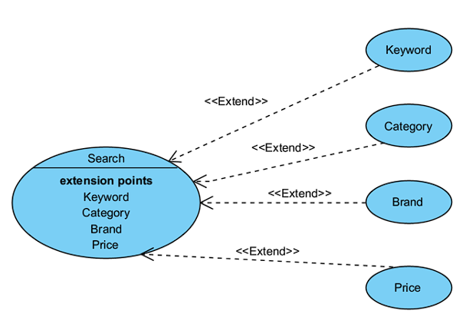
Sub diagrams

Slide 7
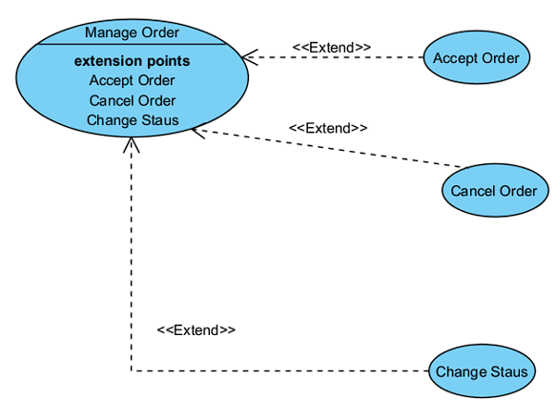
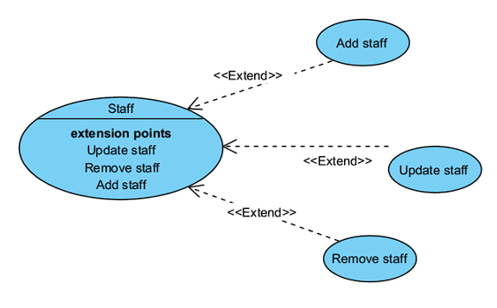
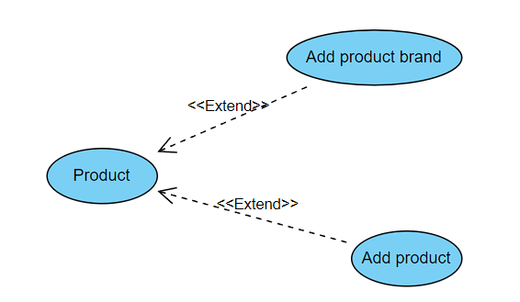

Slide 8
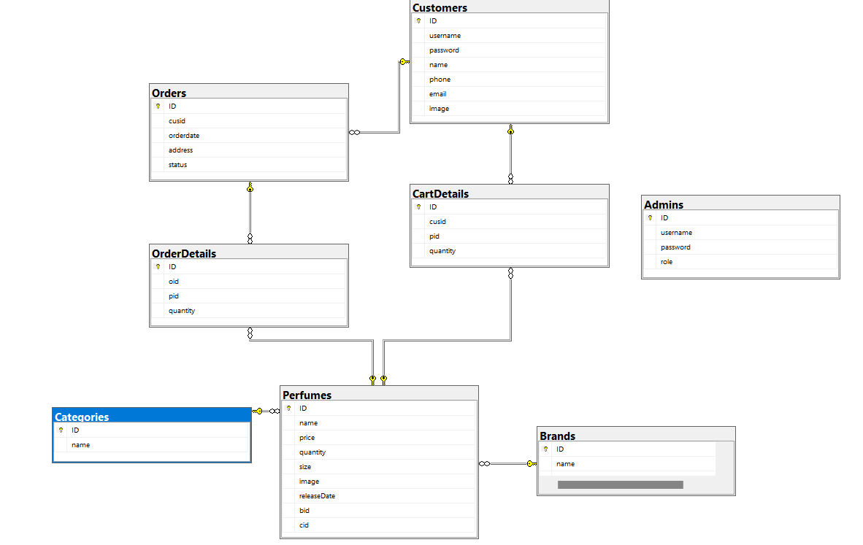
Database diagram

Slide 9
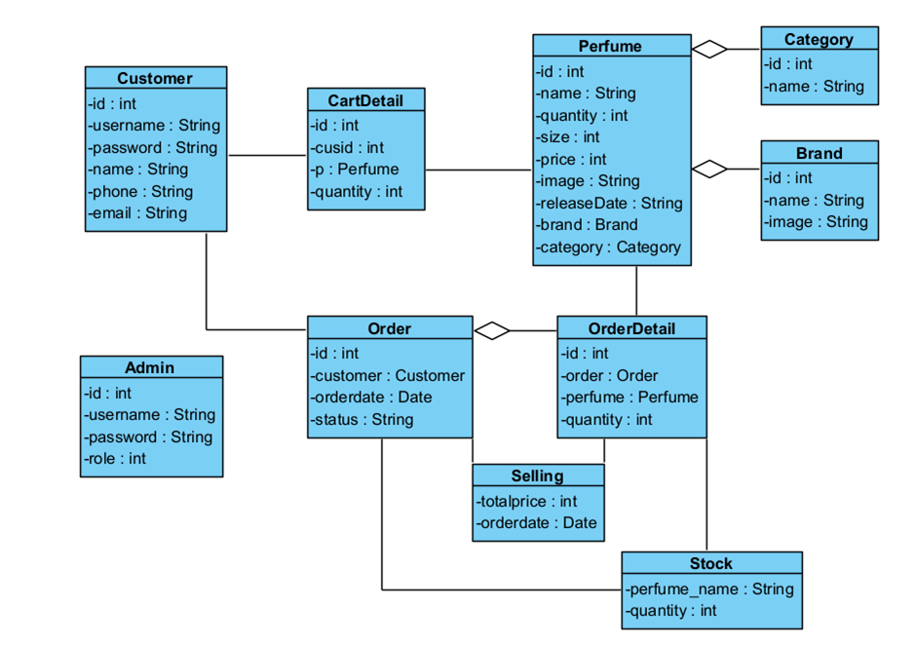
Class diagram

Slide 10
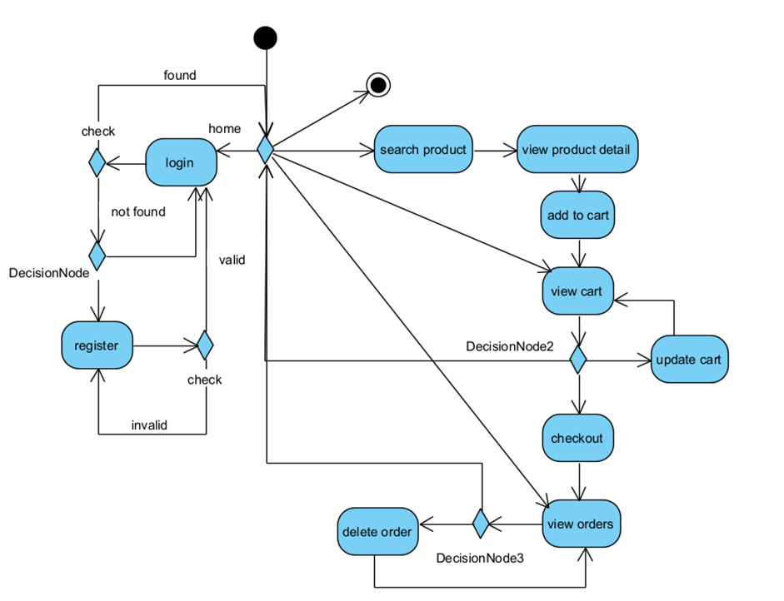
Activity diagram
Customer

Slide 11
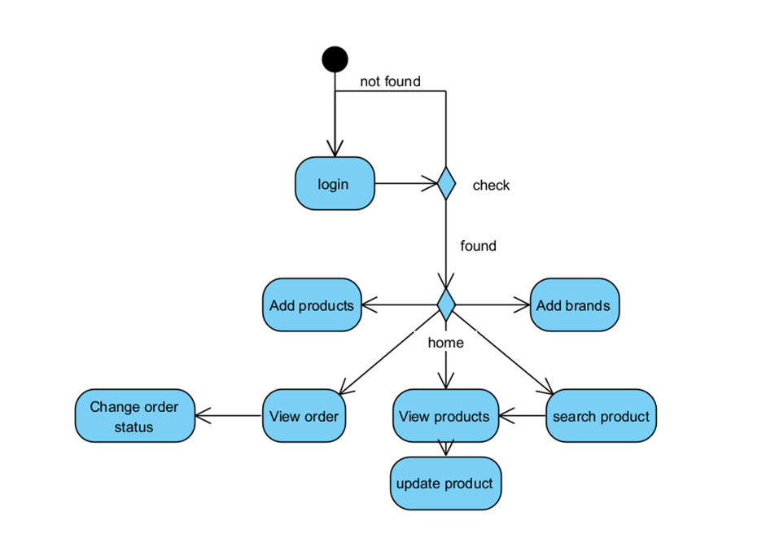
Admin

Slide 12
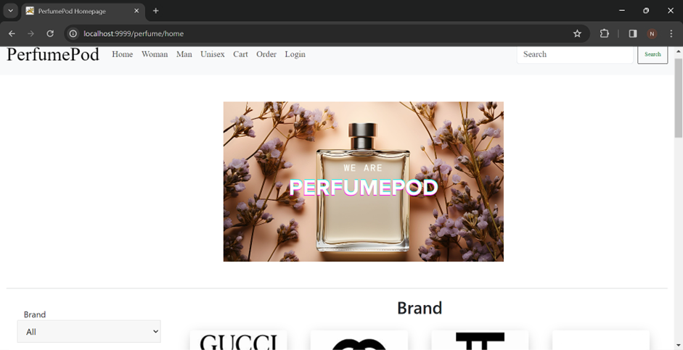
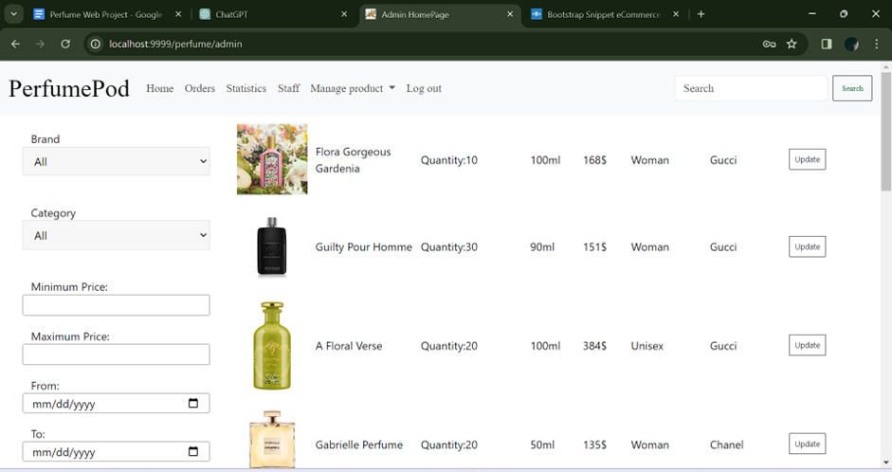
Design
Home Webpage

Slide 13
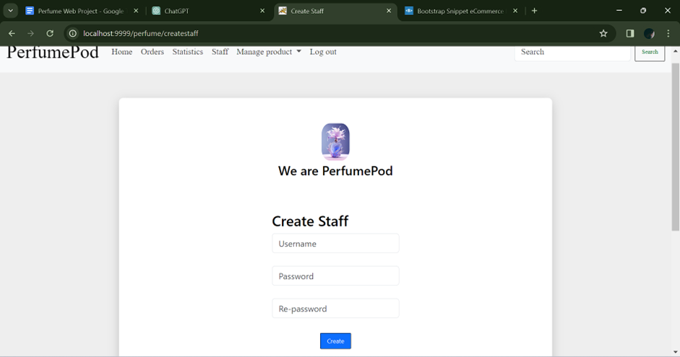

Slide 14
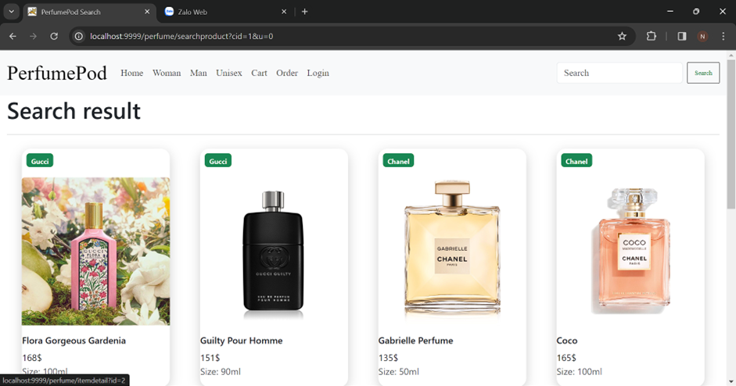
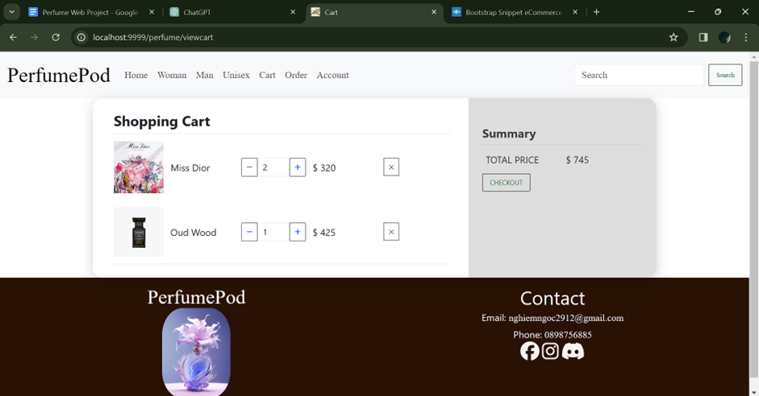
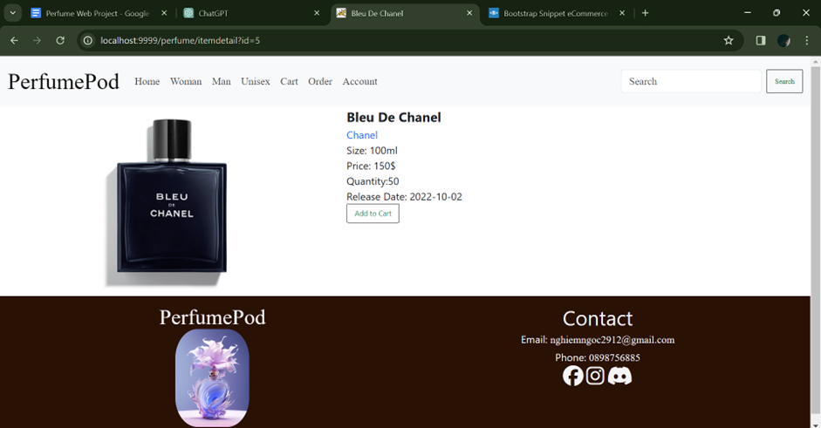
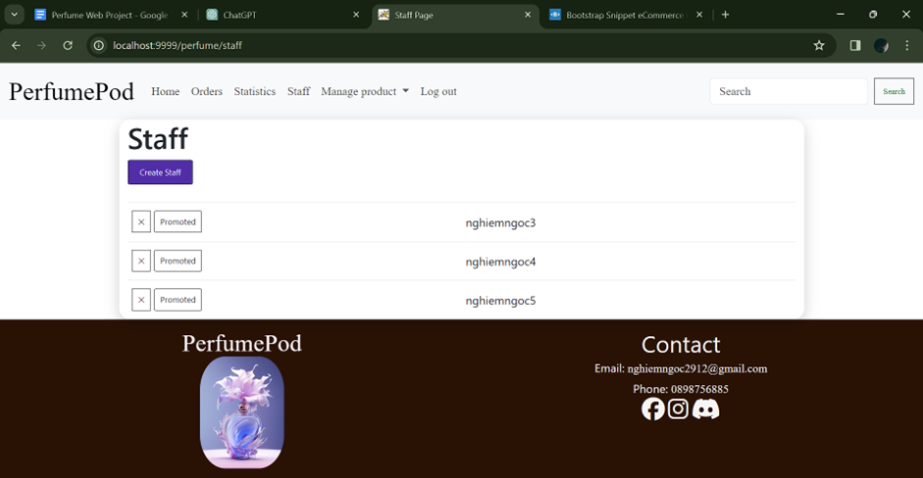

Slide 15
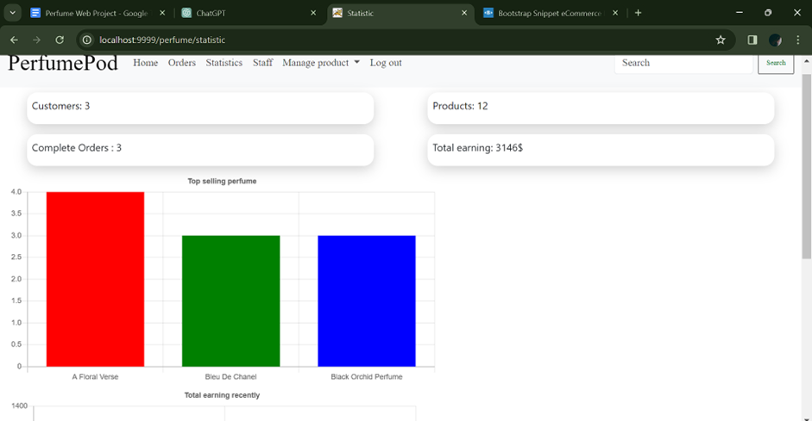

Slide 16
Conclusion
-Achievements:
+The system partially meets the needs of computerizing the product promotion process for the store and building the customer's shopping cart, making it more convenient and saving time for both parties without reducing efficiency.
+The system has a simple interface according to the current trend, which is user-friendly and easy to use for both administrators and customers.
-Limitations:
+The system still has many shortcomings in both functionality and interface.

Slide 17


